Slide 1
FinIntellect Where AI meets financial literacy.
Presented By: Tejal Bhatti

Slide 2
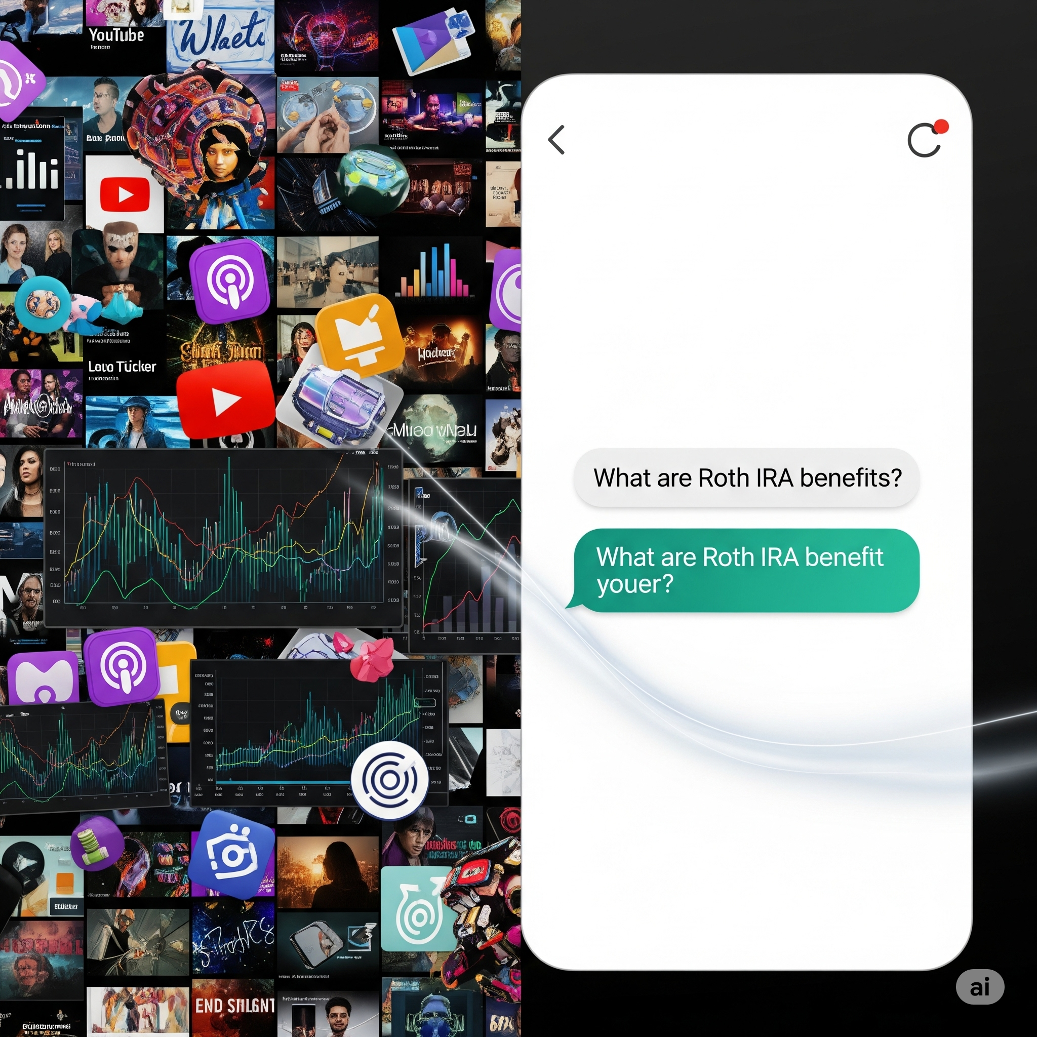
Beyond Chatbots: Your Intelligent Financial Co-Pilot
✅Ask Anything from Videos
Turn long YouTube content into instant financial answers.
🧮 Built-in Tools for Smart Advice
From savings goals to investment planning — it’s interactive, not just chat.
️️🗣️Voice & Text Interface
Accessible to everyone with speech-to-text & text-to-speech.
🧠Powered by LangChain & GPT-4o-mini
Reliable. Scalable. Grounded

Slide 3
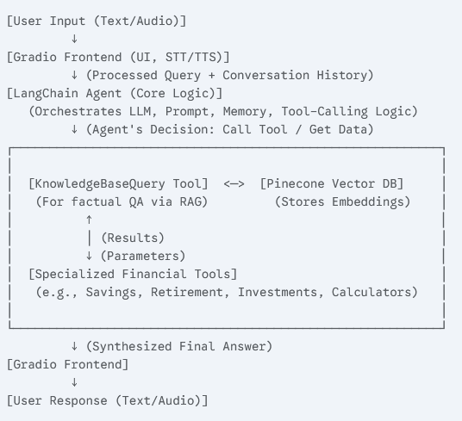
FinIntellect Architecture: The Engine Behind Intelligent Finance
Core Components:
User Interface (UI): Gradio Frontend
Orchestration Engine: LangChain Agent Executor
Large Language Model (LLM): GPT-4o-mini
Knowledge Base: Pinecone Vector Database with OpenAI Embeddings
Specialized Functions: Custom Financial Tools (RAG, Savings, Retirement, Investment, etc.)

Slide 4
Deployment: Bringing the Financial AI to Life
I. Deployable Application: frontend_gradio_app.py
Acts as the interactive web interface.
Built with Gradio for an intuitive browser experience.
Integrates key technologies:
🎙️ faster_whisper: Speech-to-Text (voice input)
🔊 gTTS: Text-to-Speech (voice output)
📄 pypdf: PDF processing (salary slip analysis)
II. User Interaction & Backend Coordination
Captures all user inputs: typed text, spoken queries, and uploaded files.
Transmits inputs to chatbot_backend.py:
Core logic (LLM + RAG)
Financial tools & analysis
Returns chatbot responses:
Shown in chat
Spoken aloud (via TTS)

Slide 5
Technical Summary: Data Ingestion & Knowledge Base
Youtube videos, URLs ---- Video IDs / API Call
YouTubeTranscriptApi library ----- Raw Transcripts
Local Transcripts Directory ----- Read Files / Text Input
Cleaning & Preprocessing ----- Cleaned Text
Text Chunking (RecursiveCharacterTextSplitter) chunk_size=500, chunk_overlap=100 ---- Processed Chunks (LangaChain Documents)
Processed Chunks (totaL 2139 chunks) ------- Ready for Embedding
Embedding ("text-embedding-ada-002") --- Vector Embeddings + Metadata
Pinecone Vector Database (dimension =1536 and batch size =100, metric='cosine') ------ Searchable Knowledge Base

Slide 6
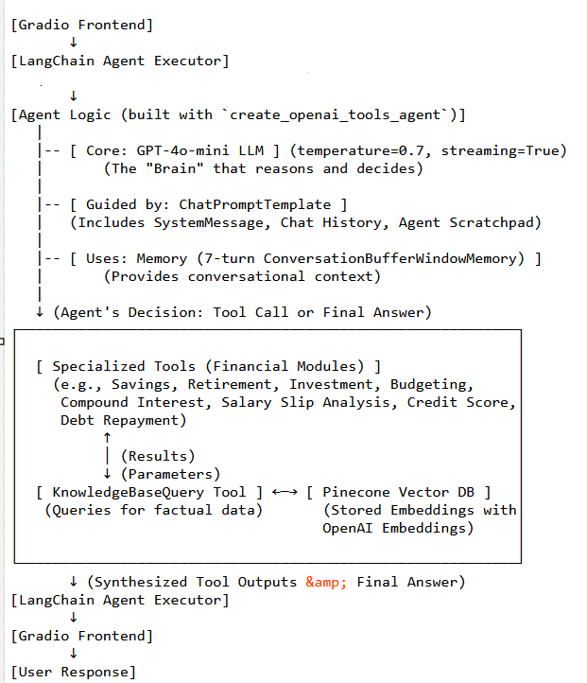
Q&A Agent: Backend Logic & Architecture

Slide 7
Tools: Extending Chatbot Capabilities
Category | Example Tools | Purpose
Knowledge Retrieval | KnowledgeBaseQuery | Semantic search using RAG (Pinecone + embeddings)
Financial Calculators | CompoundInterestCalculator, RetirementPlanning | Compute future value, retirement projections
Financial Planning | SavingsRecommendation, InvestmentAdvice, BudgetingTemplates, DebtRepaymentStrategies | Personalized advice for saving, investing, budgeting
Document Analysis | SalarySlipAnalysis | Extracts income & deductions from uploaded salary slips
Credit Improvement | CreditScoreAdvice | Suggests ways to boost credit score

Slide 8
Model Evaluation: Method, Metrics & Results
Metric | Definition | Score | Insight
Document Relevance | Are retrieved docs relevant to the query? | ✅ 100% | Excellent retrieval performance
Answer Hallucination | Any unsupported/generated content in the answer? | ⚠️ 25% | prompt tuning needed
Answer Accuracy | How well does the answer match a reference answer? | ✔️ 75% | Good accuracy; opportunity to improve reasoning depth
I. Evaluation Methodology
Approach: LLM-as-a-Judge (GPT-4o)
Platform: LangSmith
Process: Evaluated on curated dataset

Slide 9
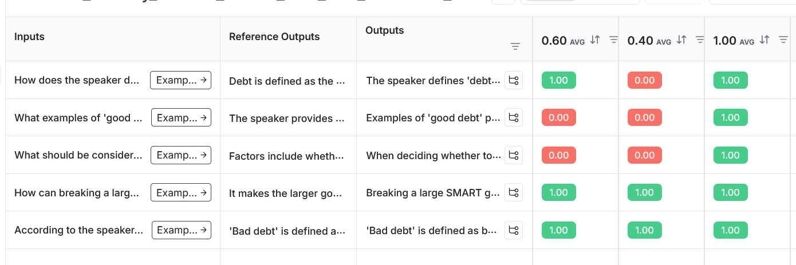
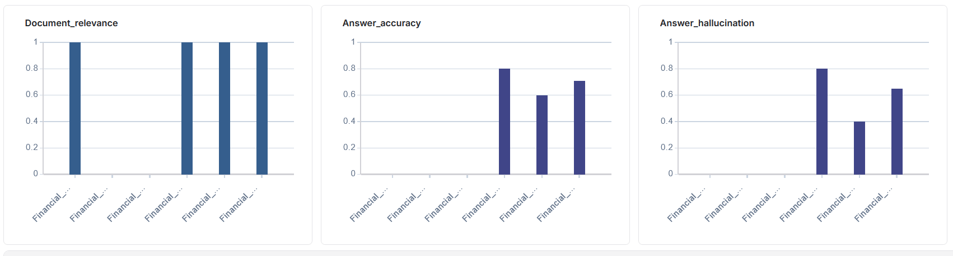
LangSmith: Evaluation Results Overview

Slide 10
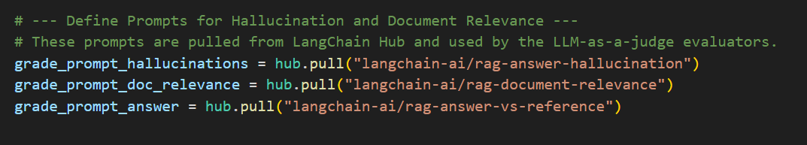
Evaluation Insight: When Perfect Retrieval Meets Zero Accuracy
⚠️ The Problem:
The system retrieved all relevant information (100% retrieval),
But the generated answer was judged 0% accurate
❌ What Happened:
The LLM-generated answer missed one key example from the context.
It did not include the specific advice/warnings expected for each example.
The evaluation requires complete alignment with the reference answer to be scored as accurate
❓ Question Asked:
"What examples of 'good debt' does the speaker provide, and what crucial advice or warnings are given for each of these examples?"
✅ Reference Answer (Expected):
Buying a House
Car/Motorcycle for Work
Education
🧾 Generated Answer:
Buying a House – ✅
Transportation for Job – ✅
Education – ❌ Missing

Slide 11

Conclusion
Work smarter, not harder — powered by AI.

Slide 12
Demo
Demo Link

